Slide 1
Prioritizing adolescents and young people in Kenya
Focus Areas
Political commitment
Strategic planning
National strategic framework
Kenya Fast track for ending HIV & AIDS in AYP
Focused programming
Multi-sectoral response
DREAMS
AYP target population for prevention services e.g. PrEP, HIV testing, communication
Ministry of Health
Ministry of Education (integrate prevention education and support care)
Youth and gender
Adolescents & young people (AYP) with HIV
10-19 years:105,200
20-24 years: 184,700
AIDs strategic framework identifies AYP as a priority population
Involving the AYP
Involvement of AYP in planning and policy development
National stock staking with AYP
National networks of AYP for engagement

Slide 3
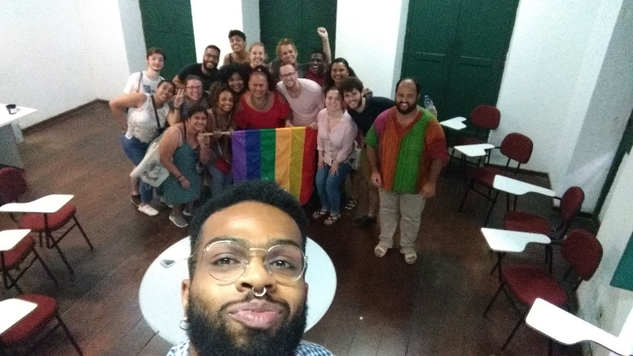
PrEP 1519- A Demonstration Project of the effectiveness of PrEP amongst adolescent MSM & TGW at high risk for HIV (Salvador, São Paulo, Belo Horizonte)
Six Components
Component 1-Formative research
Component 2- Strategies for recruitment, enrolment & linkage to the combination prevention
Focus on reach and access of adolescent and youth MSM and TGW
Map & define facilitators, barriers, & acceptability of different recruitment strategies for PrEP
Test demand creation strategies for community outreach
Venues
Social media – GSN app for sexual encounters; Youtube; Digital influencers;
Youth outreach team/peer educators/CBO partners as bridge to PrEP/health services
LGBT Center, Salvador, Brazil

Slide 4
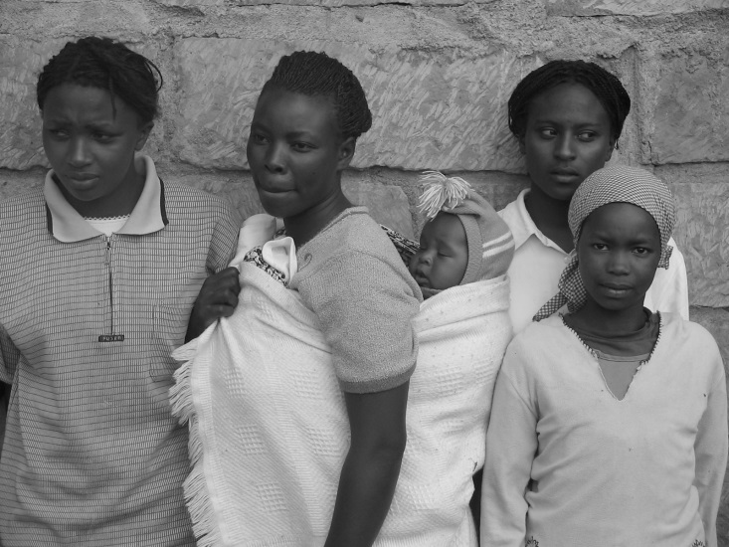
PrEP for AGYW…

Slide 5
Panelists
Irene Mukui , MD, MPH
National AIDs & STI Control Programme, Ministry of Health Kenya
imukui@Nascop.or.ke
Nittaya Phanuphak, MD, PhD
Chief, SEARCH, PREVENTION
Thai Red Cross AIDS Research Centre, Bangkok, Thailand
nittaya.p@trcarc.org
Inês Dourado, MD, MPH, PhD
Protocol Chair and Salvador PI
Health Collective Institute/ Federal University of Bahia/Brasil (www.isc.ufba.br)
ines.dourado@gmail.com
Elizabeth Anne Bukusi, MBChB, M.Med (ObGyn), MPH, PhD , PGD (Research Ethics), MBE (Research Ethics) Chief Research Officer, Co-Director Research Care Training Program,(RCTP), KEMRI, Kenya & Research Professor, Departments of Global Health and Obstetrics and Gynecology University of Washington, USA Email :ebukusi@rctp.or.ke /ebukusi@kemri.org/ ebukusi@u.washington.edu / ebukusi@gmail.com

